Slide 1
Department of Information Technology
JSS Academy of Technical Education, NOIDA Session 2021-22
MINI Project On TWITTER SENTIMENT ANALYSIS – Supervised ML
Submitted By: Saksham Garg (1900910130107) and Sumit Julka (1900910130114)

Slide 2
TABLE OF CONTENTS
Introduction
Logic Buildup
Functional Requirement
Scope Of Project
Technology Stack
Results
Conclusion and Future Scope

Slide 3
Introduction
To Perform sentiment analysis of tweets using logistic regression. What is Sentiment Analysis?
Sentiment Analysis is the process of ‘computationally’ determining whether a piece of writing is positive, negative or neutral.
It’s also helps in the opinion or attitude of a speaker.

Slide 4

How Logic Works?
To perform sentiment analysis on a tweet, you first have to represent the text (i.e. "I am happy because I am learning NLP ") First You Train Your Logistical Model. Then use it to classify the text. It predicts from the labelled model
INPUT TEXT I am happy because I am learning NLP
DATA SET
TRAIN
Classify
POS =1 or NEG=0

Slide 5
Functional Requirements
Import nltk (Natural Language Tool-Kit) To get sample tweets from corpus – so to train the model To get Regular Expressions, Porter Stemmer , Stop words, Tokenizer.
Tweet Processing ( ) 1) Remove RE { I, the is are etc}
2) remove #,@ , ! ? Etc.
3) Remove stremmer { danced , dancing , dance = dance}
4) Tokenize the sentence = {"I" , "Love" ," NLP"}

Slide 6
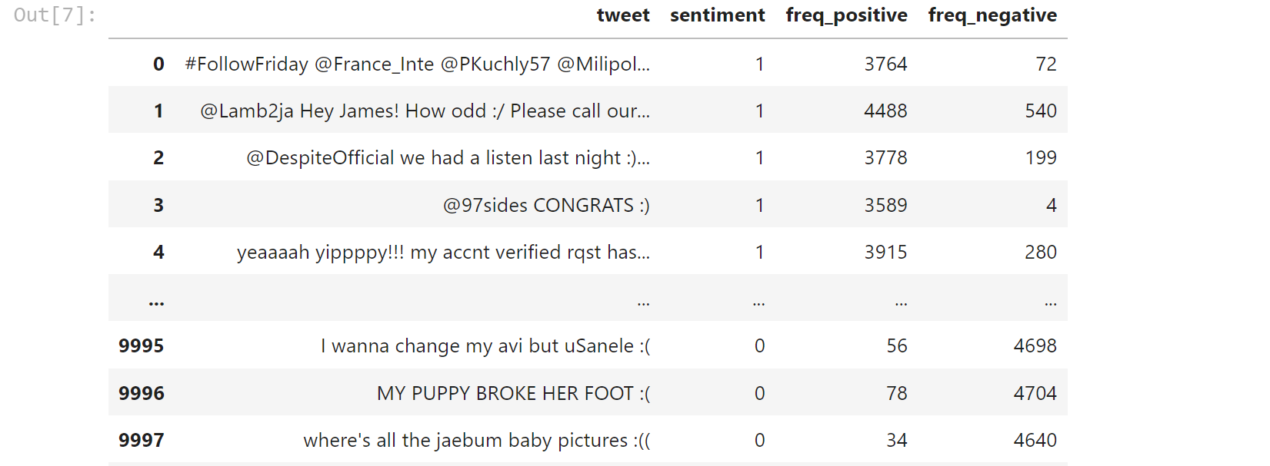
Import scikit-learn. train_test_split Train the sample dataset and mark positive as 1 and negative as 0; calculate how much times the positive tweets appeared frequency and how much times the negative tweets appeared frequency

Slide 7
import TextBlob To get the polarity of the sentence and using the model predicting the sentiment as POSITVIE , NEGATIVE , and NUETRAL
blob1=TextBlob(text)
if blob1.sentiment[0]>0:
Positive"
elif blob1.sentiment[0]==0:
Nuetral"
else:
Negative"

Slide 8
Scope of the Project

Slide 9
Business: In marketing field companies use it to develop their strategies, to understand customers’ feelings towards products or brand, how people respond to their campaigns or product Politics: In political field, it is used to keep track of political view. Mood of public. It can be used to predict election results as well!
Public Actions: Sentiment analysis also is used to monitor and analyse social phenomena, for the spotting of potentially dangerous situations and determining the general mood of the blogosphere.

Slide 10
Technology Stack
Google Collab
Python
Flask
HTML
CSS

Slide 11
Results

Slide 12
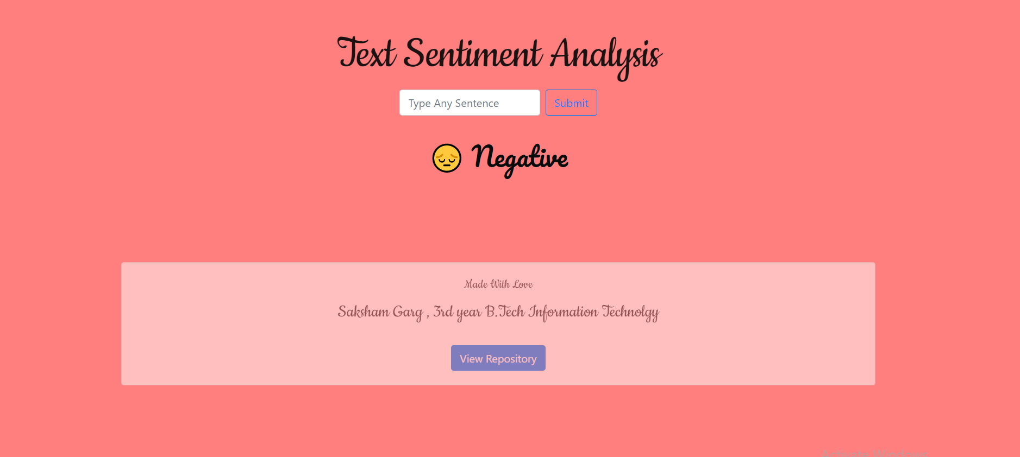

Slide 13
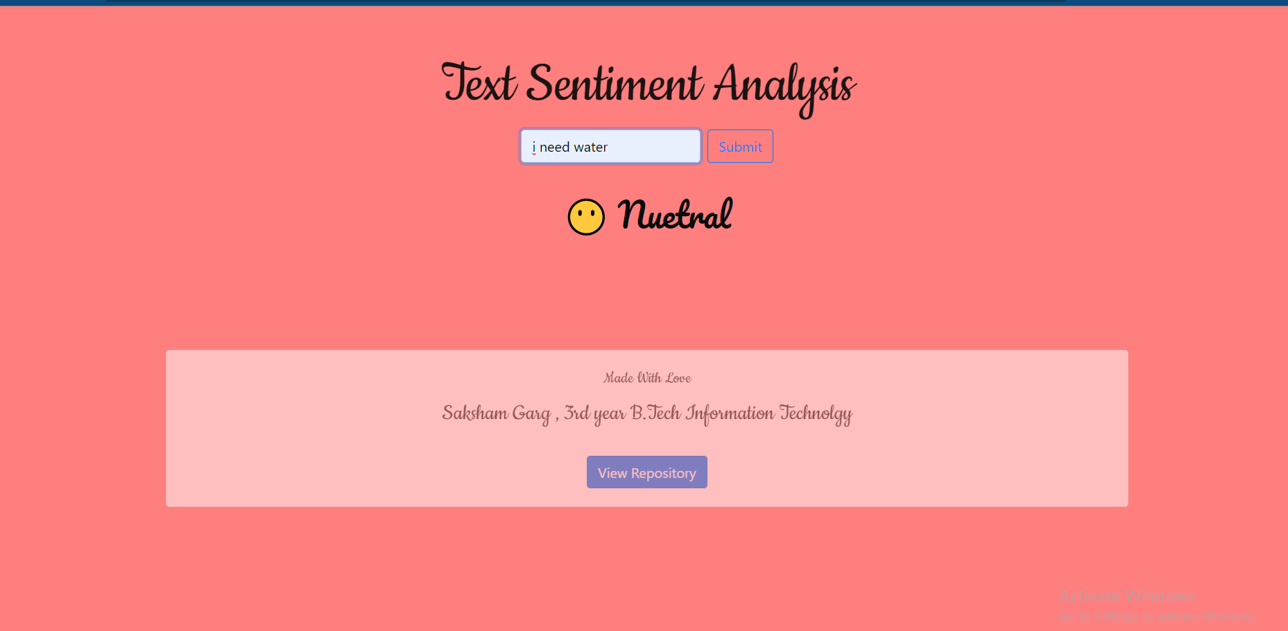

Slide 14


Slide 15
Conclusion & Future Scope
Twitter sentiment analysis management reports in python.
comes under the category of text and opinion mining. It focuses on analyzing the sentiments of the tweets and feeding the data to a machine learning model in order to train it and then check its accuracy, so that we can use this model for future use according to the results.

Slide 16

Facebook had replaced its only button, called reactions, with a slew of emojis. This enabled the user to express their emotions more freely.
As a result, every time the major social media platforms update and add new features, hence interactions becomes broader and deeper.
YouTube , Amazon etc. also uses text sentiment analysis to predict sentiment in comment box.

Slide 17

FUTURE SCOPE
• Understanding predicting political opinions and polls
• Increasing morale and boost productivity by listening to the employees and buyers
• Predict and analyze market trends
The future of sentiment analysis is limitless

Slide 18

THE END
Submitted By: Saksham Garg (1900910130107) & Sumit Julka (1900910130114)
https://github.com/sakshamceo/Twitter-Sentiment-Analysis_Project_NLP

